Slide 1
WEB AUTHORING
SESSION 02 – TEXT, LIST AND IMAGE

Slide 2
OBJECTIVES
Format text in HTML
Insert Ordered, Unordered and Definition Lists
Images on the Web

Slide 3
Modify the appearance of text
Using special characters
None break space
&nbsp;
Greater than (>)
&gt;
Less than (<)
&lt;
Quotes (“ “)
&quot;
Ampersand (&)
&amp;

Slide 4
Modify the appearance of text (cont..)
Headings
<HTML>
<HEAD>
<TITLE>Introduction to HTML</TITLE>
</HEAD>
<H1>Introduction to H1</H1>
<H2>Introduction to H2</H2>
<H3>Introduction to H3</H3>
<H4>Introduction to H4</H4>
<H5>Introduction to H5</H5>
<H6>Introduction to H6</H6>
</HTML>

Slide 5
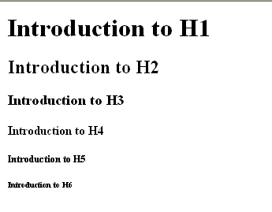
Heading output

Slide 6
Modify the appearance of text (cont..)
“division” tags:
<DIV>section of text</DIV>: defines the boundaries of a section of text and divides or separates that section from the rest of the text.
A line break automatically is inserted before and after a divided section.

Slide 7
Div sample
<DIV ALIGN="LEFT"><H3>High Flying</H3>
I gazed down into valleys,<BR>
At the snowcaps white as cream!
</DIV>
<DIV ALIGN="CENTER"><H3>High Flying</H3>
I gazed down into valleys,<BR>
At the snowcaps white as cream!</DIV>
<DIV ALIGN="RIGHT"><H3>High Flying</H3>
I gazed down into valleys,<BR>
At the snowcaps white as cream!</DIV>

Slide 8
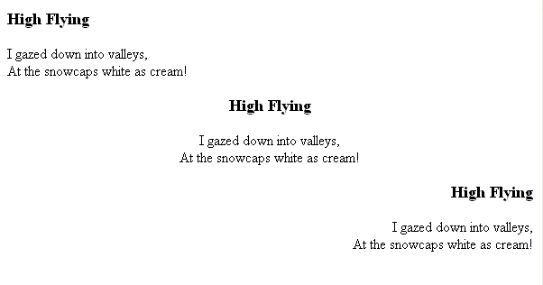
Div output

Slide 9
Modify the appearance of text (cont..)
<CENTER>text…</CENTER>: horizontally centers print and other objects on a page
<SUB>number</SUB>: lowers a number or a character slightly below the midline level.
<SUP>number</SUP>: elevates a number or a character slightly above the midline level.
<PRE>text</PRE>: preformats text, preserving the spacing between the words and characters as typed

Slide 10
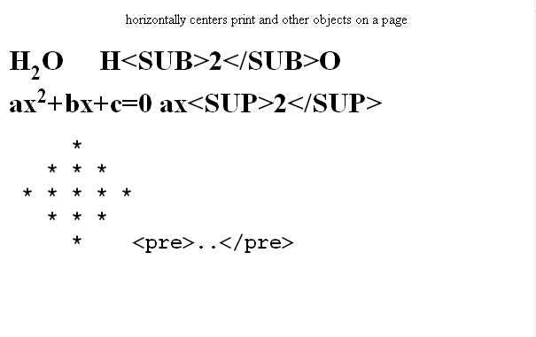
Output

Slide 11
List
HTML Unordered List
An unordered list starts with the <ul> tag. Each list item starts with the <li> tag.
<ul> <li>Coffee</li> <li>Milk</li> </ul>
How the HTML code above looks in a browser:
Coffee
Milk

Slide 12
HTML Unordered List
Customized bullets
<LI TYPE = SQUARE> Square bullets
<LI TYPE = DISC> Sphere bullets
<LI TYPE = CIRCLE> Round bullets

Slide 13
List (cont..)
HTML ordered Lists
An ordered list starts with the <ol> tag. Each list item starts with the <li> tag.
The list items are marked with numbers.
<ol> <li>Coffee</li> <li>Milk</li> </ol>
How the HTML code above looks in a browser:
Coffee
Milk

Slide 14
HTML ordered List
Customized Numbers
Upper Roman
<LI TYPE = I>
Lower Roman
<LI TYPE = i>
Uppercase
<LI TYPE = A>
Lowercase
<LI TYPE = a>
Begin numbering with a digit other than 1
<OL START = n> [ Default ]

Slide 15
List (cont..)
Definition list
<DL><FONT SIZE="4"> <DT>HTML <DD>Hypertext Markup Language <DT>TP <DD>Transfer Protocol <DL> <DT>FTP <DD>File Transfer Protocol </DL>

Slide 16
Image on the Web
Some image formats:
GIF (Graphics Interchange Format) images (.GIF)
Interlaced GIF format
Transparent GIF images
JPEG (Joint Photographic Expert Group) images (.JPEG)
PNG (Portable Network Graphics)
In HTML, images are defined with the <img> tag.
Syntax for defining an image:
<img src="url" alt="some_text"/>

Slide 17
Insert image into HTML document
<IMG SRC=”board.jpg” width=200>
<IMG ALIGN=left SRC=”PICTURE.GIF”>
<IMG SRC=Flowers.jpg ALT=”Beautiful Flowers”>
<BODY BACKGROUND=bgimage.gif>
<BODY BACKGROUND=bgimage.gif BGPROPERTIES=FIXED>

Slide 18

Output

Slide 19
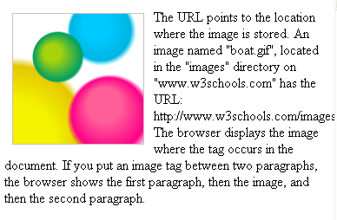
Output image with align=left

Slide 20
Summary
In this session, we learnt:
Format text in HTML
Insert Ordered, Unordered and Definition Lists
Images on the Web
<img src="url" alt="some_text"/>

